Slide 2
BEFORE METHOD
The fuzzy edges of paradigmatic knowledgeS
EXPULSIONS
Analytic Tactics

Slide 3
ANALYTIC TACITCS
Destabilizing stable meanings
In the shadows of powerful explanations
RELOCALIZING BITS AND PIECES OF “THE” ECONOMY
When territory exits conventional framings
it becomes institutionally mobile, nomadic and can alter the meaning of “the” economy.

Slide 4
we make...

Slide 5
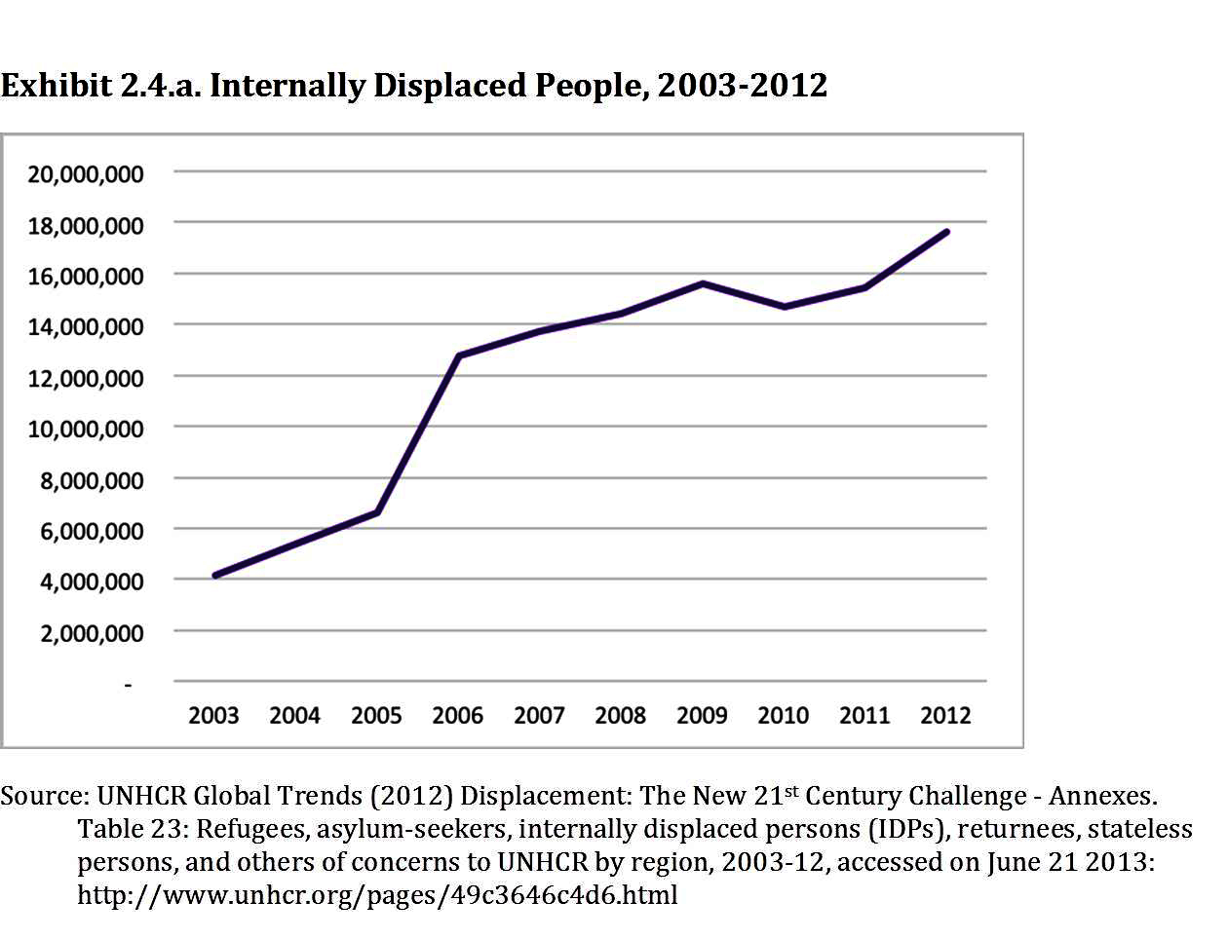

Slide 6
and we make environmental destructions

Slide 7
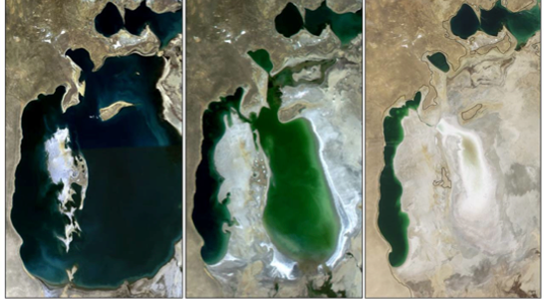
Exhibit 5.9. Aral Sea, 1989-2009

Slide 8
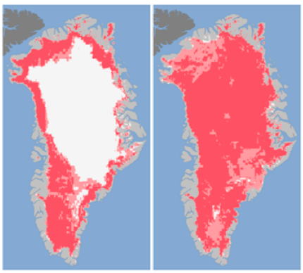
Exhibit 5.11. Extent of Surface Melt over Greenland’s Ice Sheet, 2012
Source: Viñas, Maria-José. "Satellites See Unprecedented Greenland Ice Sheet Surface Melt." NASA. Accessed July 30, 2012. http://www.nasa.gov/topics/earth/features/greenland-melt.html.

Slide 10
  WHAT IS THE STEAM ENGINE
  OF OUR EPOCH?
  THAT WHICH HAS BEEN ABLE TO MAKE A NEW ORDERING –not change everything, but make a new ordering.
  WHAT IS IN AND WHAT IS OUT IN THIS NEW ORDERING?

Slide 11
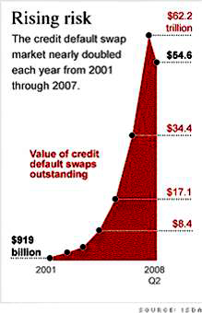

Slide 12
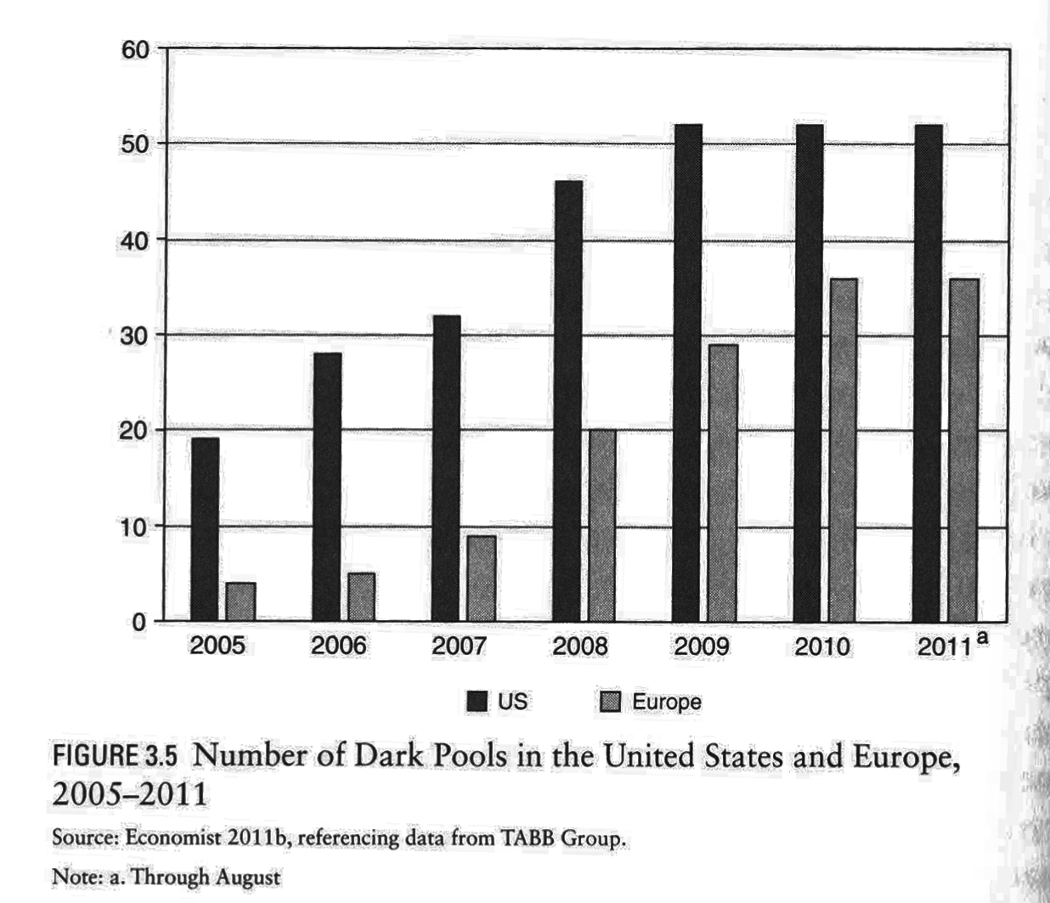

Slide 13
When modest neighborhoods become part of global finance
The making of instruments that enable the use of modest elements/assets to build a powerful financial instrument useful to top level investors: sub-prime mortgage for low- and modest-income households.
The key is that the source of profits for investors is NOT payment on the mortgage. All that is needed is a signed contract.
The source of profits is the bundling of a large number of these mortgages with high-value debt to sell them on to investors, including banks and foreign investors. It worked because they were mixed up with high quality debts of all sorts.

Slide 14
Expulsions: New foreclosures per year(2006-14)
2006 : 1.2 million foreclosures, up 42% from 2005. This is: One in every 92 U.S. households
2007: 2.2 million foreclosures, up 75% from 06
2008: 3.1 million, up 81% from 07
2009: 3.9 million (or 1 in 45 US hholds)
(From 2007 to 2009: 120% increase in forecls)
2010: 2.9 mill forecls. (2006-2010: over 13 mil)
Source: Data from the Fed Reserve, organized by RealtyTrac 2007, 2008, 2009, 2010.

Slide 15
2011: 2,698,967 (3.4 percent decrease from 2010)
2012: 2,304,941 (3 percent decrease from 2011)
2013: foreclosures filed on 1,361,795 properties
First half of 2014: foreclosure filed on 613,874 properties
Source: RealtyTrac
Notes:
Slide 3 update

Slide 16
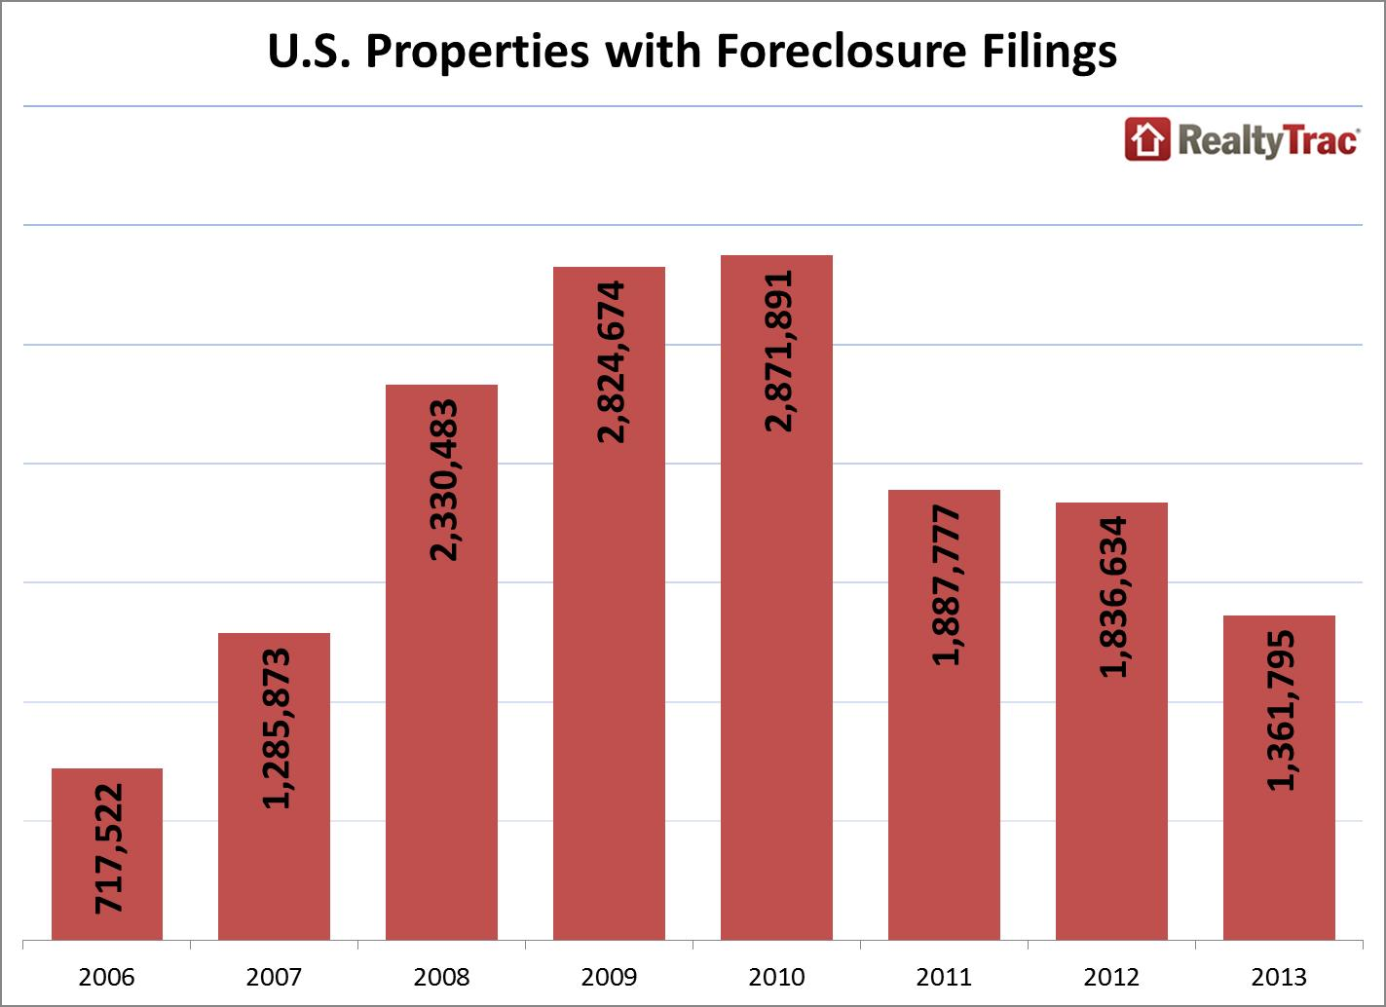
Notes:
Slide 3 update

Slide 17
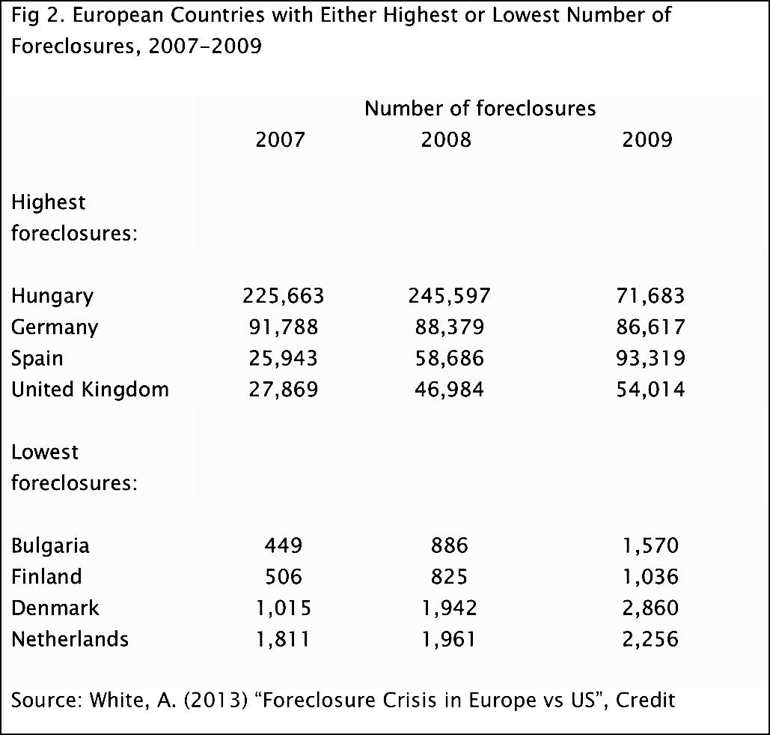

Slide 18
THE OUTCOME:
EMPTY URBAN LAND

Slide 19
YET ANOTHER MUTATION OF URBAN LAND

Slide 20
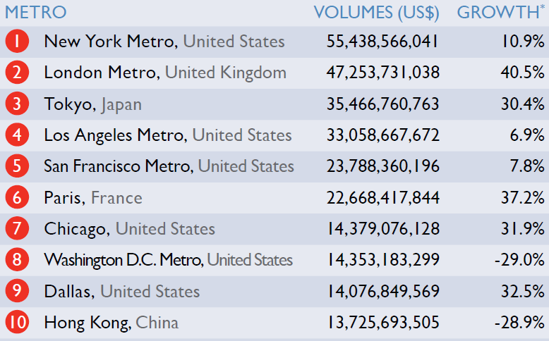
TOTAL(national and foreign) INVESTMENT VOLUMES
(EXcept DEV. SITES, Q3 2013 – Q2 2014)

Slide 21
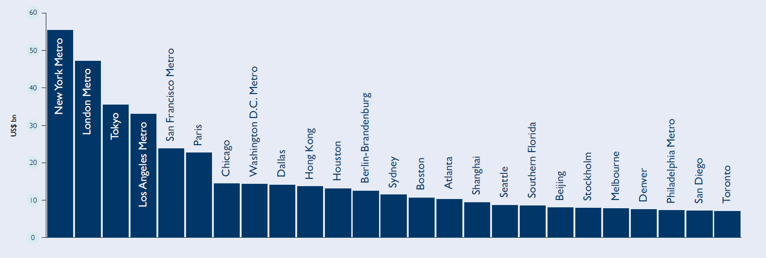
Top 25 cities for TOTAL property investment
(EXCEPT DEV. SITES, q3 2013 – q2 2014)

Slide 22
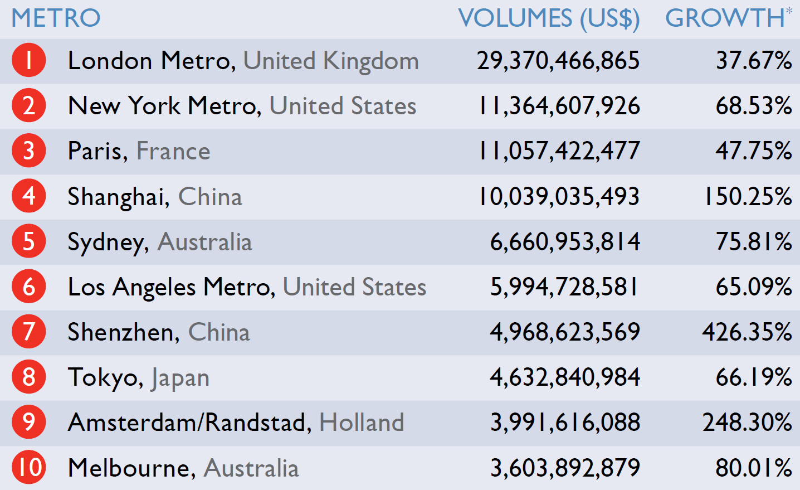
Total FOREIGN investment volumes
(Q3 2013 – Q2 2014)

Slide 24
NEW SYSTEMICS?

Slide 25
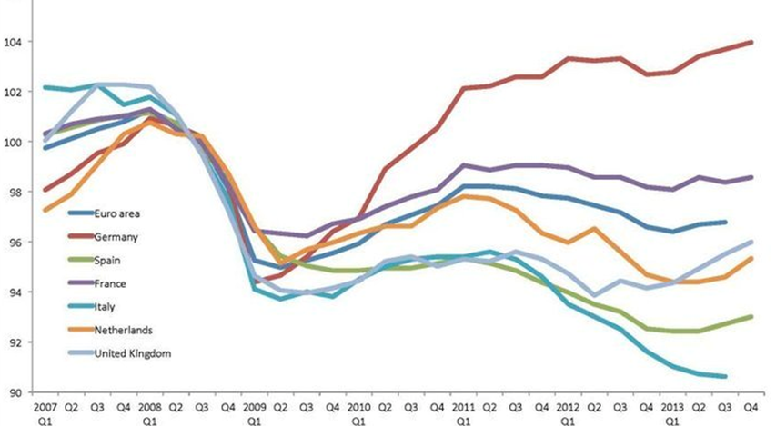
GDP per capita 2007-2013, select European countries (2008=100)
Source: Office of National Statistics of the United Kingdom 2014.

Slide 26
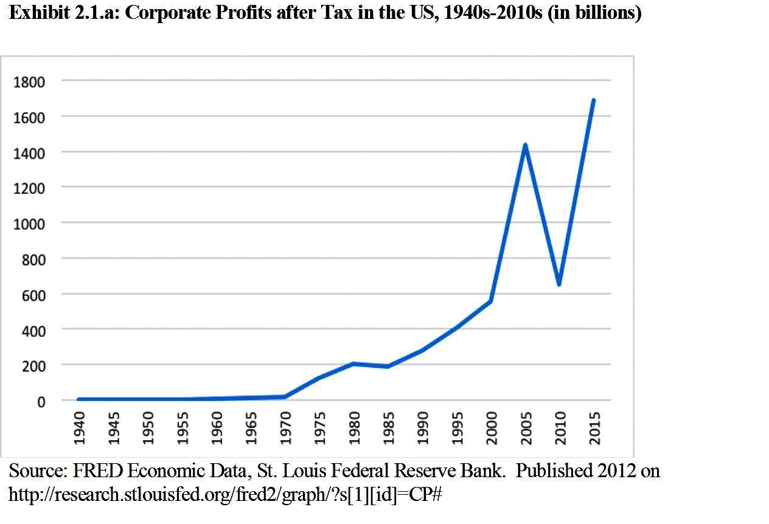

Slide 27
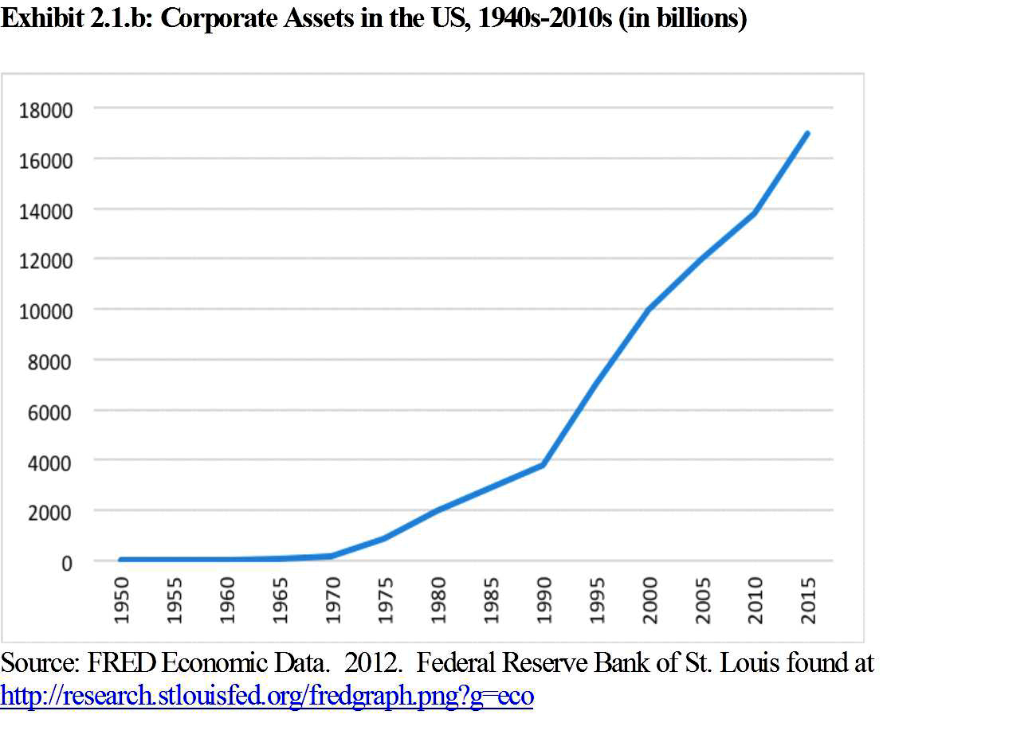

Slide 28
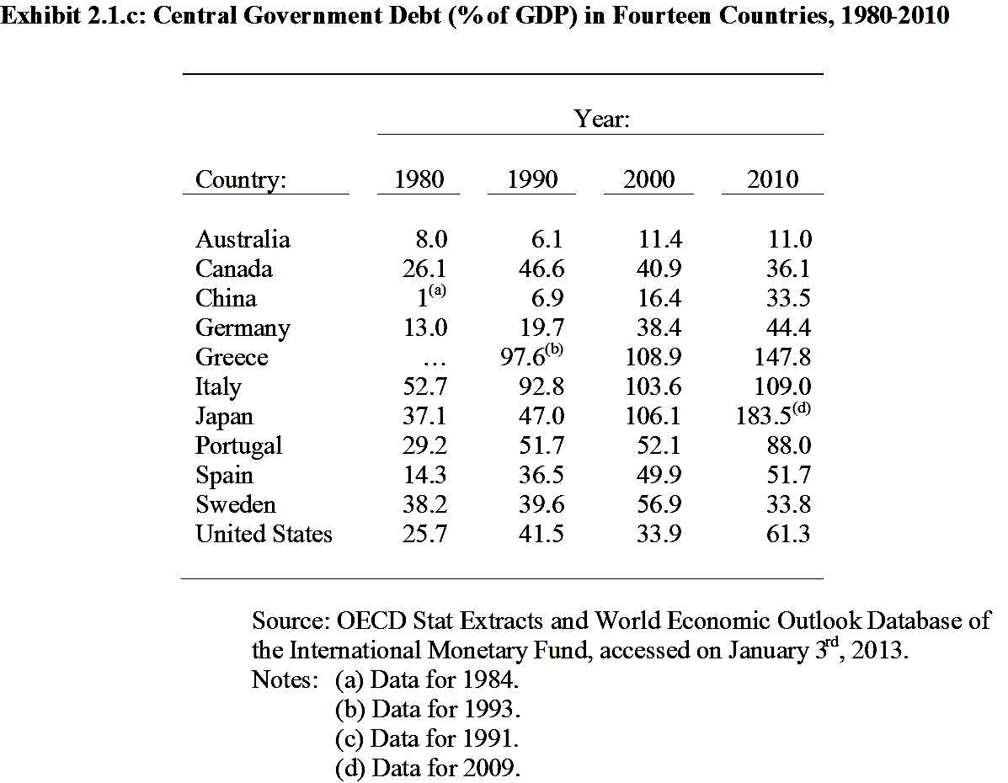

Slide 29
The bridge into even the most modest households

Slide 30
DEBT

Slide 31
Table 8: Ratio of Household Credit to Personal Disposable Income (2000-05)
 | 2000 | 2001 | 2002 | 2003 | 2004 | 2005
Emerging Markets
Czech Republic | 8.5 | 10.1 | 12.9 | 16.4 | 21.3 | 27.1
Hungary | 11.2 | 14.4 | 20.9 | 29.5 | 33.9 | 39.3
Poland | 10.1 | 10.3 | 10.9 | 12.6 | 14.5 | 18.2
India | 4.7 | 5.4 | 6.4 | 7.4 | 9.7 | …
Korea | 33.0 | 43.9 | 57.3 | 62.6 | 64.5 | 68.9
Philippines | 1.7 | 4.6 | 5.5 | 5.5 | 5.6 | …
Taiwan | 75.1 | 72.7 | 76.0 | 83.0 | 95.5 | …
Thailand | 26.0 | 25.6 | 28.6 | 34.3 | 36.4 | …
Mature Markets
Australia | 83.3 | 86.7 | 95.6 | 109.0 | 119.0 | 124.5
France | 57.8 | 57.5 | 58.2 | 59.8 | 64.2 | 69.2
Germany | 70.4 | 70.1 | 69.1 | 70.3 | 70.5 | 70.0
Italy | 25.0 | 25.8 | 27.0 | 28.7 | 31.8 | 34.8
Japan | 73.6 | 75.7 | 77.6 | 77.3 | 77.9 | 77.8
Spain | 65.2 | 70.4 | 76.9 | 86.4 | 98.8 | 112.7
United States | 104.0 | 105.1 | 110.8 | 118.2 | 126.0 | 132.7
Source: IMF Staff estimates based on data from country authoriies, CEIC, OECD, and Bloomberg

Slide 32
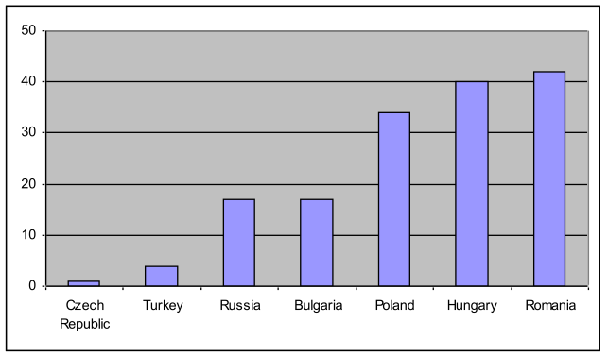
Table 11: Share of Foreign-Currency-Denominated Household Credit, End-2005 (In percent of total household credit)
Source: IMF 2006. “Global Financial Stability Report: Market Developments and Issues.” IMF: World Economic and Financial Surveys. September, 2006. Retrieved August 26, 2008. [http://www.imf.org/external/pubs/ft/GFSR/2006/02/pdf/chap2.pdf] p. 54

Slide 34
Income Share of top 10% earners,
USA 1917-2005
*Income is defined as market income but excludes capital gains
Source: Mishel, L. 2004. “Unfettered Markets, Income Inequality, and Religious Values.” Viewpoints. May 19, 2004. Economic Policy Institute. Retrieved July 26, 2008 [ www.epi.org/content.cfm/webfeatures_viewpoints_moral_markets_presentation.]

Slide 35
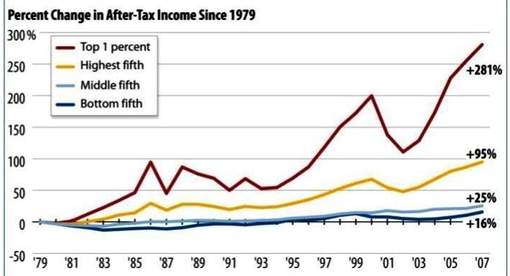
% Growth in After-Tax Income, USA 1979-2007
Notes:
Top 1% of earners saw an increase of 281% in their after tax income from 1979 to 2007

Slide 36
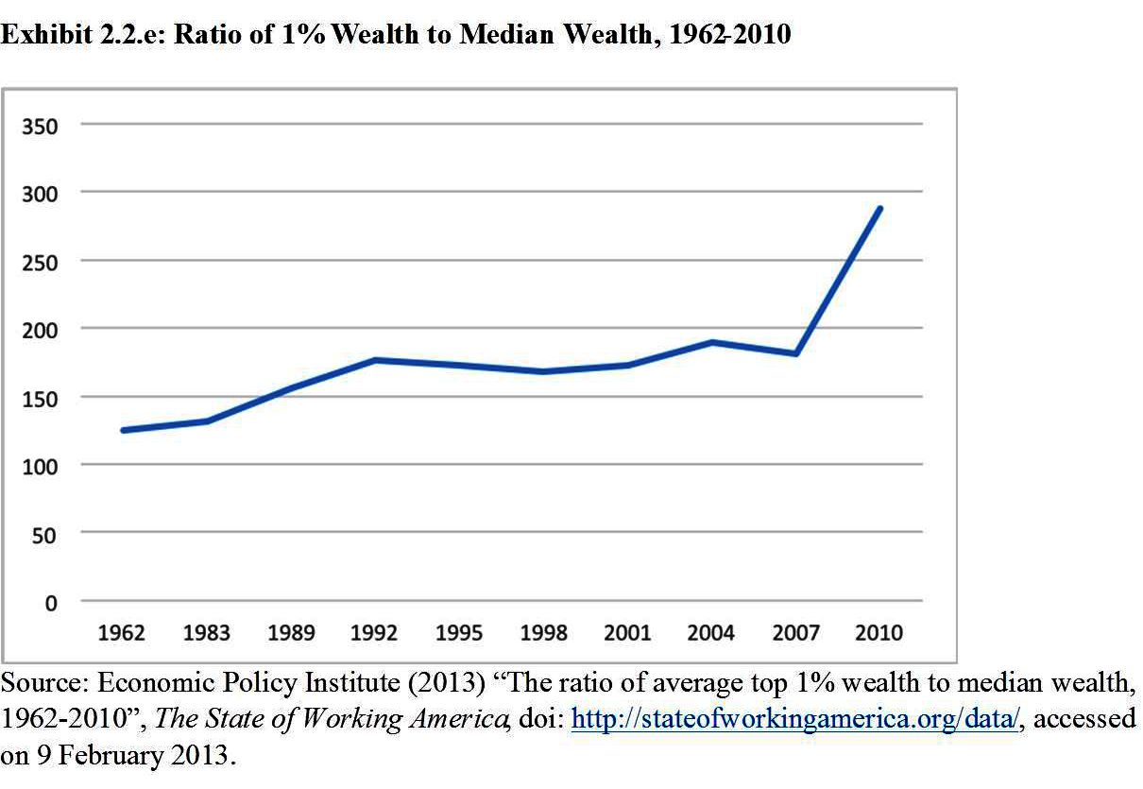

Slide 37
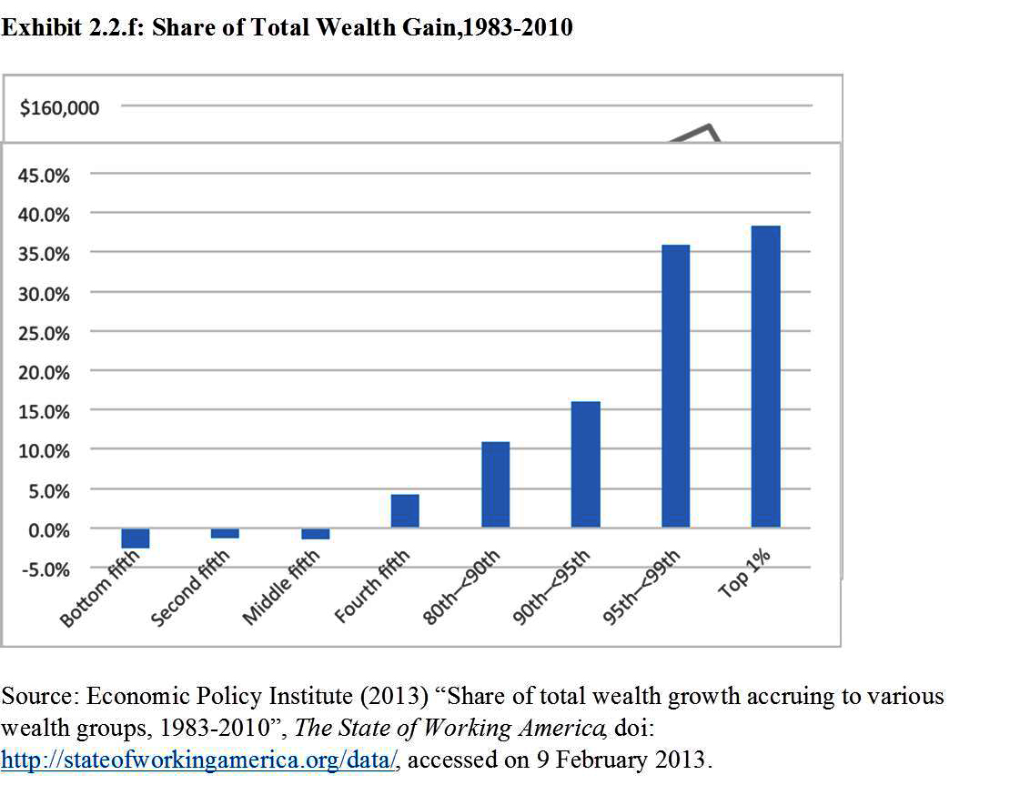

Slide 39
IN THE SHADOWS OF URBANIZATION
.

Slide 40
One instance of what we measure as development but is actually a massive expulsion
From 2006 to 2010: 220 million hectares of land in Afri, LatAm, Cambodia, Ukraine etc bought/leased by rich governments, firms, financial firms
The land is now more valued than the people or activities on it
The active making of surplus populations
Novel assemblage of Territory/Authority/Rights

Slide 41
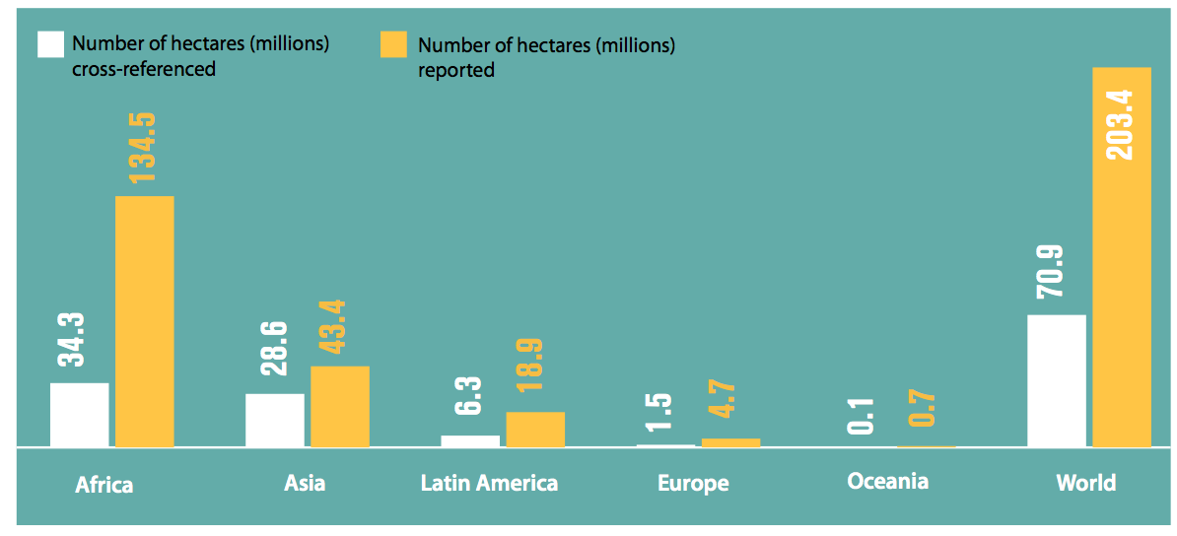

Slide 42
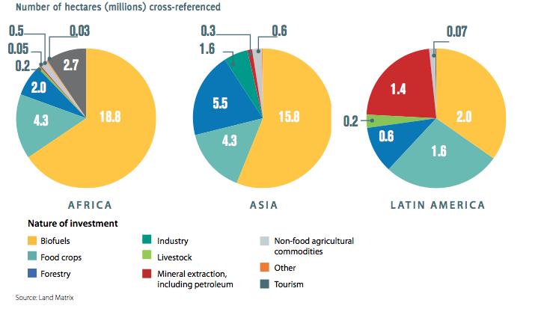

Slide 43
MORE LAND GRABBING BECAUSE MUCH LAND IS DYING

Slide 44
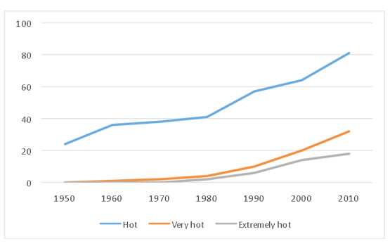
Northern hemisphere: Land Area with Hot, Very Hot, and Extremely Hot Temperatures, 1960-2010
Source: World Bank (2013) The Heat Turn Down: Why a 4C Warmer World Must Be Avoided. Figure 18: Northern Hemisphere land area covered by hot (>0.43σ), very hot (>2σ) and extremely hot (>3σ) summer temperatures, accessed on June 26th 2013.

Slide 45
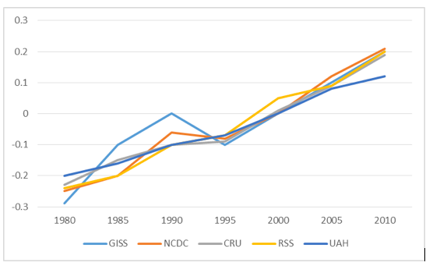
Exhibit 5.7 Temperature Data: Multiple Sources Confirm Warming Trend, 1980-2010
Source: World Bank (2013) The Heat Turn Down: Why a 4C Warmer World Must Be Avoided. Figure 3: Temperature data from different sources - GISS: Godard Institute for Space Studies; NCDC: National Climate Data Center; CRU: Climate Research Unit; RSS: Remote Sensing Systems; UAH: University of Alabama at Huntsville, accessed on June 29th 2013.

Slide 46
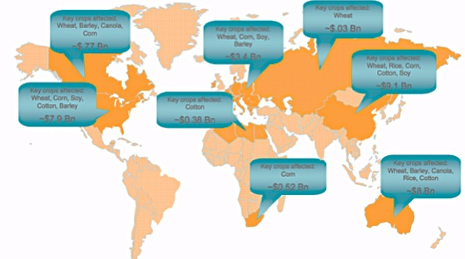
Exhibit 5.8. Water Already Limiting Agricultural Productivity, 2009
Source: Gonzalez-Valero, Juan. Climate, Land Degradation, Agriculture and Food Security: Means to Adopt. Report. September 2009. Accessed July 30, 2012. http://www.wmo.int/wcc3/sessionsdb/documents/WS10_Gonzalez.pdf.

Slide 48
RELOCALIZING WHATEVER
WE CAN RELOCALIZE
.

